Slide 1


26th March 2024
Introduction to Copyright
Prof.ssa Emanuela Arezzo
EUILAP seminars: Copyright Law in the Digital Age

Slide 2
Copyright between history and the development of technology
How does copyright arise?
Birth of printing press and sovereign privileges granted to booksellers and printers.
In England, the concept of copyright originated with the Statute of Anne (April 17, 1710)
In France: Act of 4-11 August 1789 on the abolition of feudalism (abolition of all privileges) and Art. 11 of the“Déclaration des droits de l’homme et du citoyen” enshrining freedom of the press.
In 1793 (Act of July 19) the first major legislation protecting “les auteurs d’écrits en tout genre, les compositeurs de musique, les peintres et dessinateurs”.
In Italy, it was necessary to wait until Act No. 1950 of November 7, 1925, for the first regulation of copyright.

Slide 3
International conventions and treaties.
Berne Convention for the Protection of Literaly and Artistic Works, September 9, 1886.
WIPO Copyright Treaties
TRIPS Agreement

Slide 4
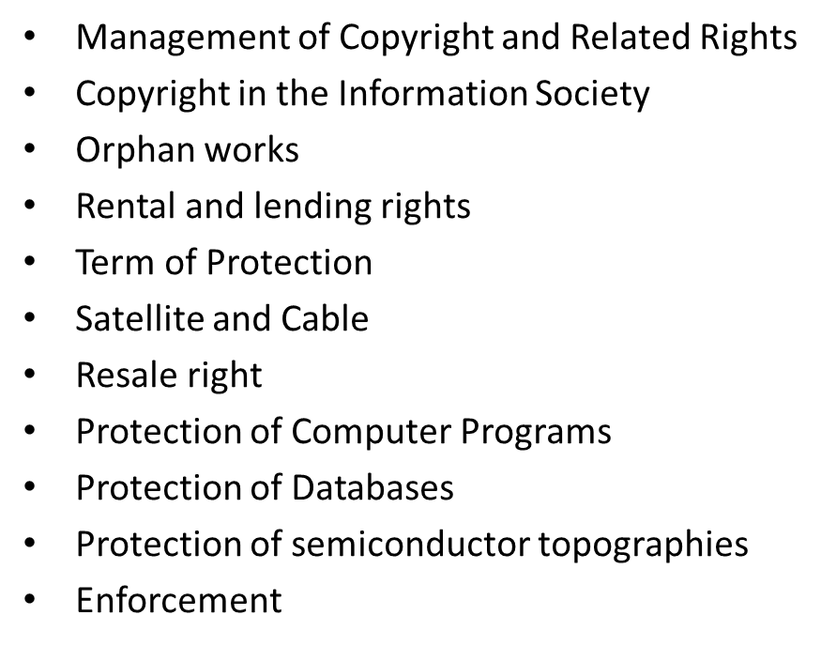
The EU legal framework
(“acquis communautaire”)
An EU copyright is missing.
Several directives and 2 regulations, harmonising the essential rights of authors, performers, producers and broadcasters.

Slide 5
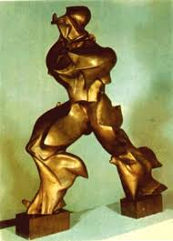

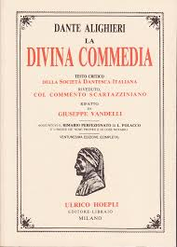
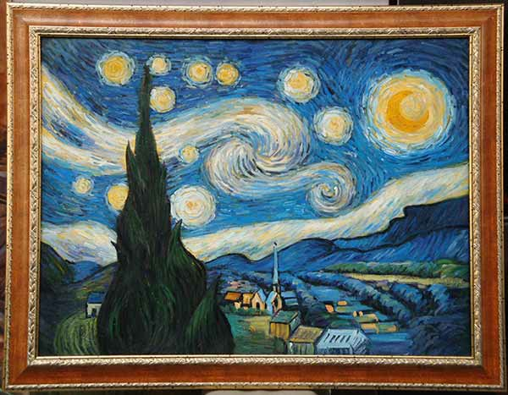

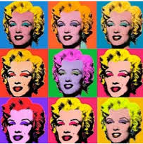
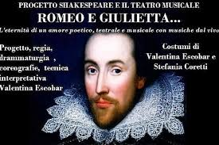
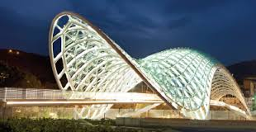
What kind of works does it protect?
Authorial/Original Works
«Works that express an author’s own intellectual creation, in the sense of resulting from her free and creative choices and bearing her personal mark» (Pila, Torremans 2019 p. 266)

Slide 6
Authorial/Original works
Art. 2, of the Berne Convention
(1) The expression "literary and artistic works" shall include every production in the literary, scientific and artistic domain, whatever may be the mode or form of its expression, such as
- books, pamphlets and other writings;
- lectures, addresses, sermons and other works of the same nature;
- dramatic or dramatico-musical works;
- choreographic works and entertainments in dumb show;
- musical compositions with or without words;
- cinematographic works to which are assimilated works expressed by a process analogous to cinematography;
- works of drawing, painting, architecture, sculpture, engraving and lithography;
- photographic works to which are assimilated works expressed by a process analogous to photography;
- works of applied art; illustrations, maps, plans, sketches and three-dimensional works relative to geography, topography, architecture or science.

Slide 7
Authorial/Original works
Art. 2, of the Berne Convention
(3) Translations, adaptations, arrangements of music and other alterations of a literary or artistic work shall be protected as original works without prejudice to the copyright in the original work.
(5) Collections of literary or artistic works such as encyclopaedias and anthologies which, by reason of the selection and arrangement of their contents, constitute intellectual creations shall be protected as such, without prejudice to the copyright in each of the works forming part of such collections.
(7) Subject to the provisions of Article 7 (4) of this Convention, it shall be a matter for legislation in the countries of the Union to determine the extent of the application of their laws to works of applied art and industrial designs and models, as well as the conditions under which such works, designs and models shall be protected. Works protected in the country of origin solely as designs and models shall be entitled in another country of the Union only to such special protection as is granted in that country to designs and models; however, if no such special protection is granted in that country, such works shall be protected as artistic works.

Slide 8
Authorial/Original works
Information Society Directive
Any combination of words, sounds, movement, colour, etc. even if part of a larger work.
Article 6 of the Term Directive
“Protection of photographs
Photographs which are original in the sense that they are the author's own intellectual creation shall be protected in accordance with Article 1. No other criteria shall be applied to determine their eligibility for protection. Member States may provide for the protection of other photographs.”

Slide 9
Authorial/Original works
Database Directive
“[…] the term ‘database’ should be understood to include literary, artistic, musical or other collections of works or collections of other material such as texts, sound, images, numbers, facts, and data; […] it should cover collections of independent works, data or other materials which are systematically or methodically arranged and can be individually accessed;”

Slide 10
Authorial/Original works
Software Directive
Computer programs, graphic user interfaces, programming languages, computer functionality, computer data files (though these may be authorial works in their own right)
TRIPS Agreement 1994 and WCT
Contracting Parties shall comply with Articles 1 to 21 and the Appendix of the Berne Convention (art. 1, par. 4)
Copyright protection extends to expressions and not to ideas, procedures, methods of operation or mathematical concepts as such. (art. 2)
Protect “computer programs…as literaly works under the Berne Convention” and “compilations of data or other materials…which by reason of the selection or arrangement of their contents constitute intellectual creations”. (Articles 9 and 10 TRIPS Agreement and Articles 1(4), 2, 4, and 5 WCT.

